Slide 1


Enhancing Sales for BigBasket
FACULTY ADVISORS
Dr. Aaditya Chandel
Dr. Ashwin J. Baliga
Name: Imran Ashraf
Roll No: 22f1001972
BS, IIT Madras, Chennai

Slide 2
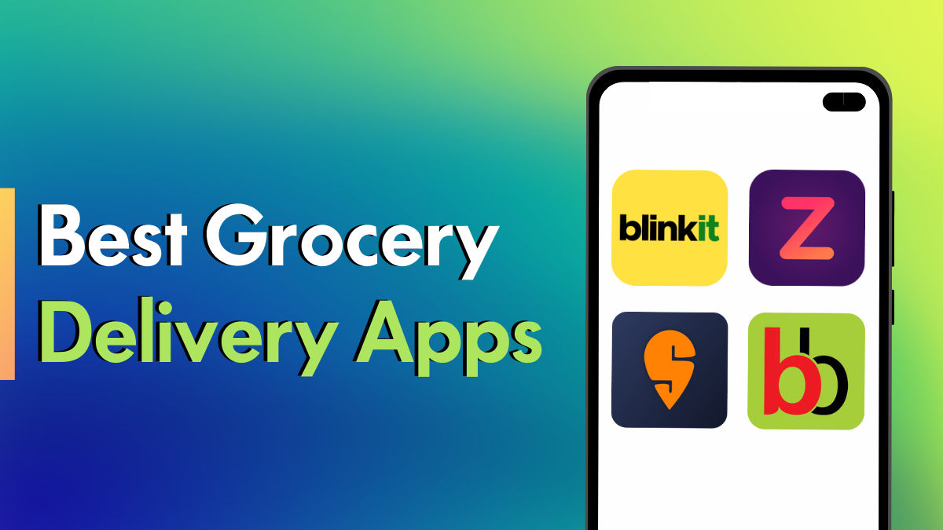
Organization Background
2
Big Basket Overview:
India’s leading online grocery platform.
Faces competition from Zepto, Blinkit, and Instamart.
Key Challenges:
Inventory mismanagement.
Customer complaints on product quality.
Product Catalog:
27,555 products across 10+ categories (e.g., Beauty & Hygiene, Gourmet Foods, Fruits & Vegetables).
Dataset: Sourced from Kaggle (28K datapoints).

Slide 3
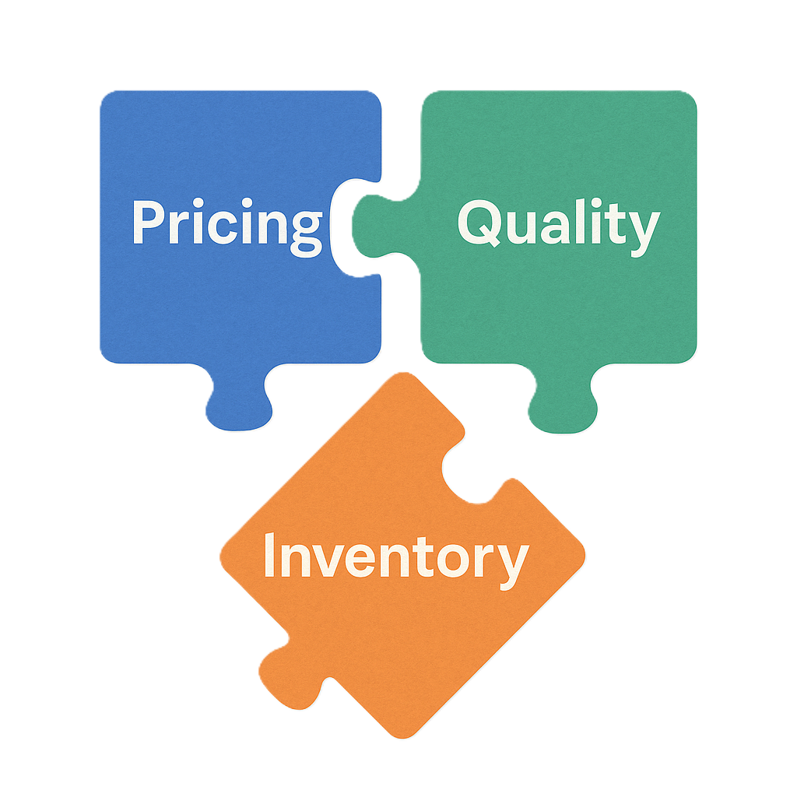
Problem Statement
Address pricing (₹) transparency issues: Address inflated market prices and artificial discounts.
Improve quality control in low-rated categories: Reduce low-rated products through quality control.
Enhance Inventory Management: Align stock levels with demand trends.

Slide 4
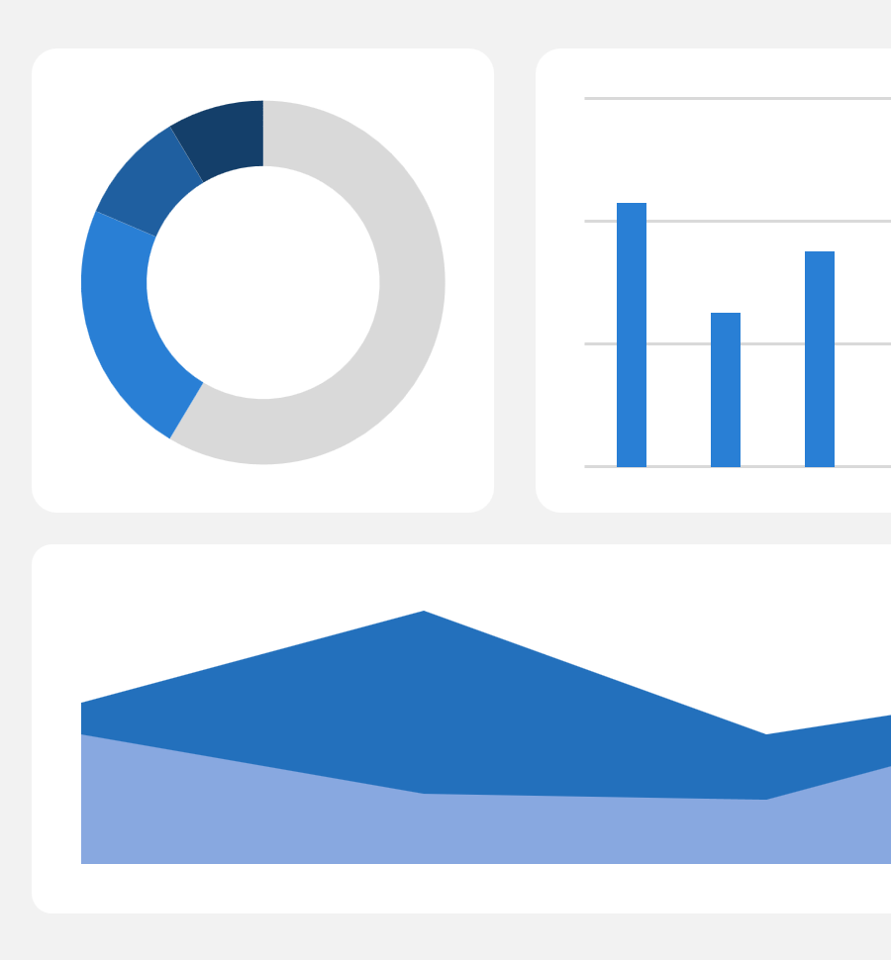

Data Collection &Methodology
Data Source:
Secondary dataset from Kaggle dataset (27,555 products, 10 features).
Columns: Price, Rating, Category, Discount, etc.
Tools: Python (Pandas, Matplotlib, Seaborn).
Steps:
Data Cleaning: Handled missing ratings and consolidating categories.
EDA: Outlier detection, correlation analysis, univariate/bivariate analysis.
Key Metrics: Average sale price (₹322.51), avg discount (11.83%), and rating (3.94/5).

Slide 5
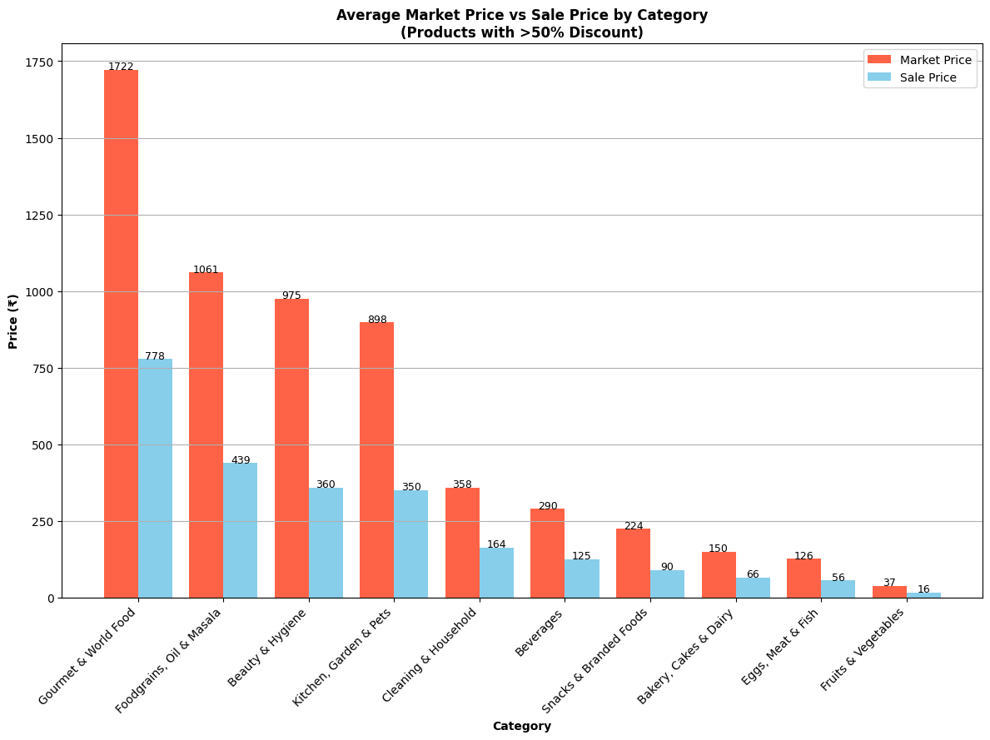
Results & Findings (1/3) – Inflated Discounts
Key Insight:
Artificially inflated market prices (50–60% discounts).
Categories like Beauty & Hygiene (63% discount) and Gourmet Foods (55% discount) show inflated MRPs.
High discounts mask inflated MRPs in premium categories.

Slide 6
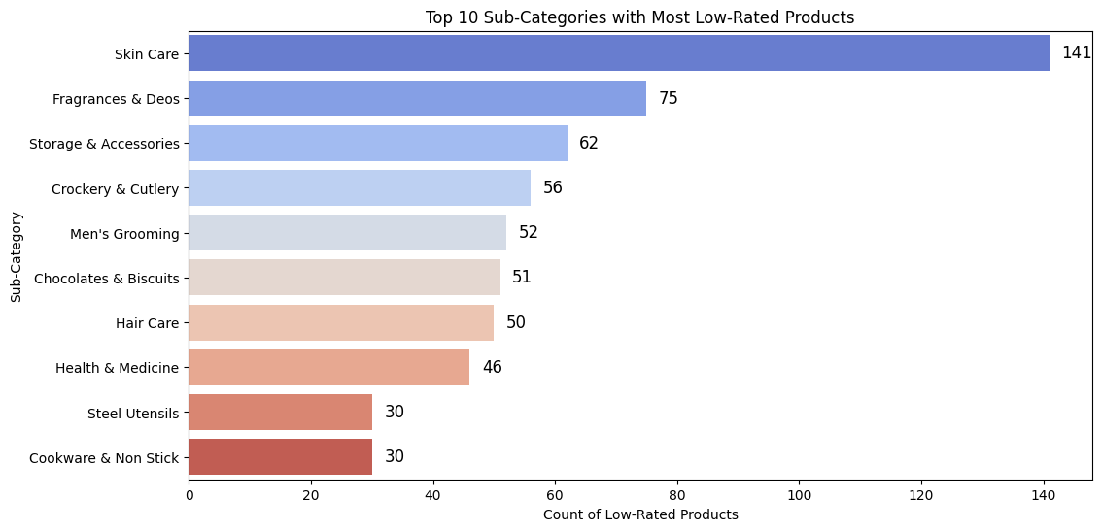
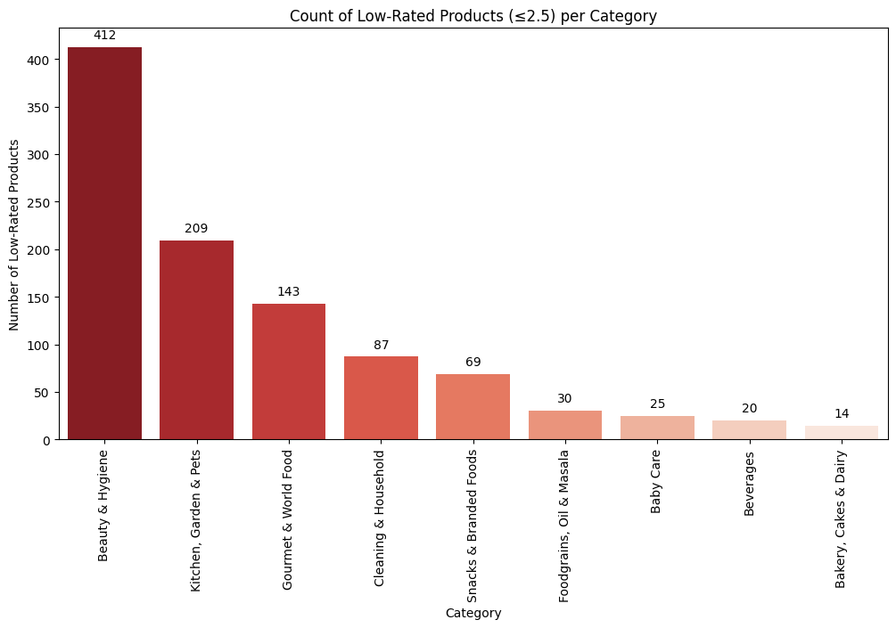
Results & Findings (2/3) – Low-Rated Products
Key Insight:
412 low-rated products in Beauty & Hygiene having less then 2.5 stars rating
Top sub-categories: Skin Care (141), Fragrances (75).
Skin Care and Fragrances need urgent quality audits.

Slide 7
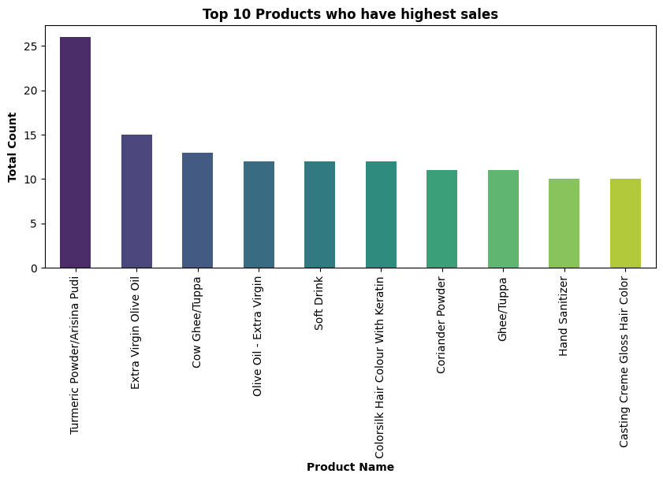
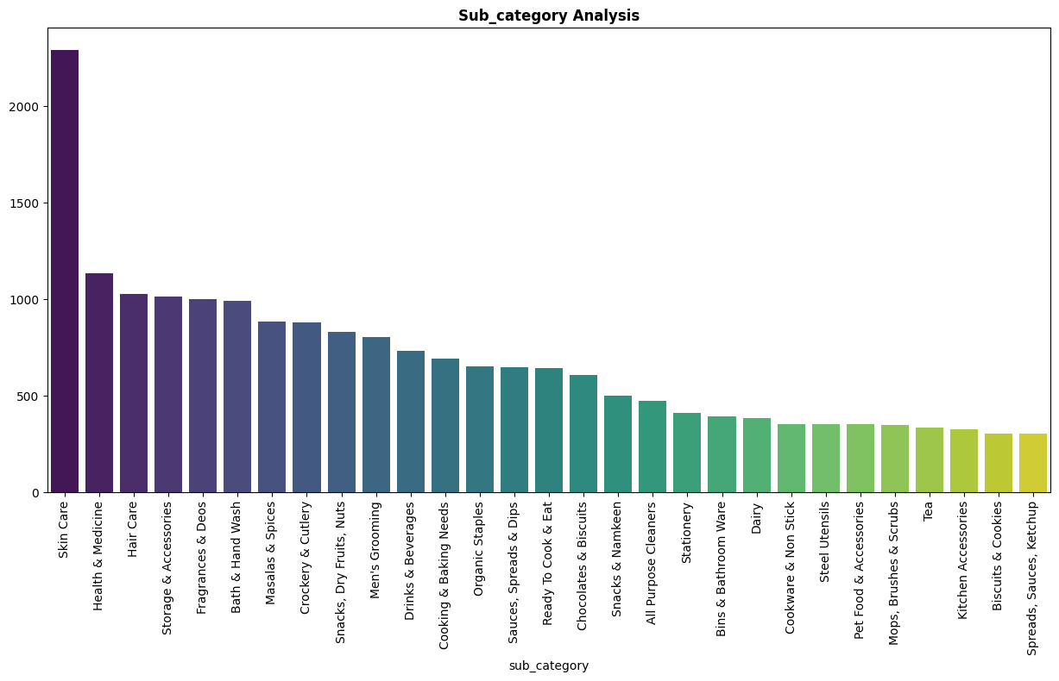
Results & Findings (3/3)-Inventory Management Insights
Key Insight:
High demand but low stock for essentials (Turmeric, Ghee).
Perishables (Fruits, Vegetables) face shelf-life challenges.
Stock optimization needed for daily essentials.

Slide 8
Interpretation & Recommendations
Interpretation:
Inflated prices erode trust; low ratings signal quality issues.
Recommendations:
Transparent Pricing
Audit MRPs to eliminate artificial markups.
Quality Control
Partner with suppliers to improve low-rated SKUs (e.g., Skin Care/Fragrances).
Stock Optimization
Prioritize high-demand essentials (Turmeric, Ghee) with dynamic restocking.

Slide 9

Conclusion & Next Steps
Impact:
Improved customer trust and inventory turnover.
Next Steps:
Partner with suppliers for quality assurance.
Pilot AI-driven stock management.

Slide 10

Thank You
Google Colab used for analysis :https://colab.research.google.com/drive/1ClP7zoa2s24_RoFS6ZQUi_JwmlcpzXv q?usp=sharing
Kaggle (Dataset): https://www.kaggle.com/datasets/surajjha101/bigbasket-entire-product-list-28k-datapoints/data

